Slide 1
Chapter I
Introduction
All class materials including this PowerPoint file are available at
https://github.com/medialab-ku/openGLESbook

Slide 2
3D Computer Graphics
Three-dimensional (3D) computer graphics takes as input 3D representations of objects and performs various calculations on them to produce images called frames.
An illusion of movement is generated on the screen by displaying a sequence of changing frames.
If the frames are produced online, we call it real-time graphics.
  More than 30 frames per second (fps)
  Games, virtual/augmented reality, and interactive user interfaces (UIs)
On the other hand, visual effects in films often take as long as minutes or hours for a single frame. In return, we may obtain photorealistic images.
The algorithms and techniques adopted in real-time graphics are fairly different from those in off-line graphics.
This class is on real-time graphics.
1-<number>

Slide 3
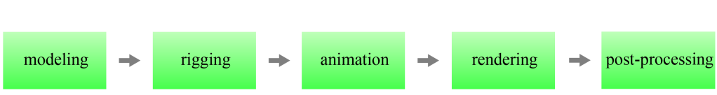
Computer Graphics Production
Major steps in computer graphics production
Graphic artists and programmers are the key players.
  Modeling, rigging, and animation are off-line tasks performed by the artists.
  At run time, computer programs replay the animation and perform rendering and post-processing.
1-<number>

Slide 4
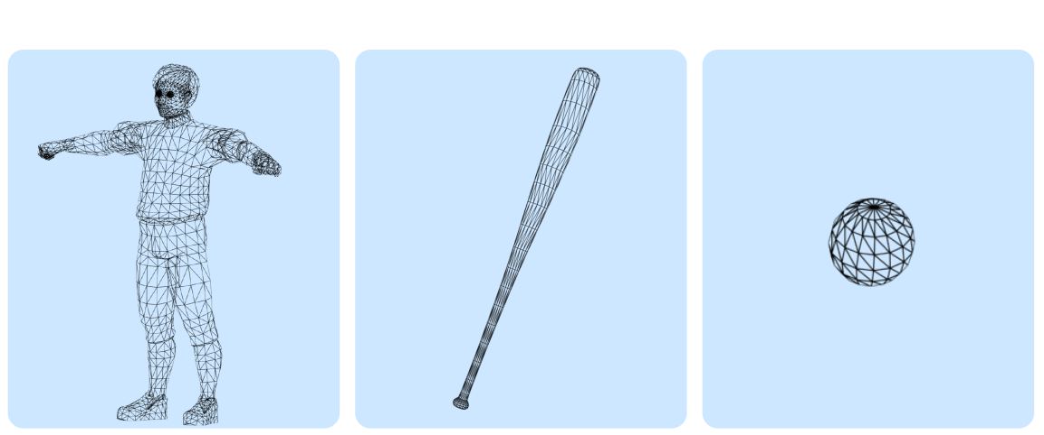
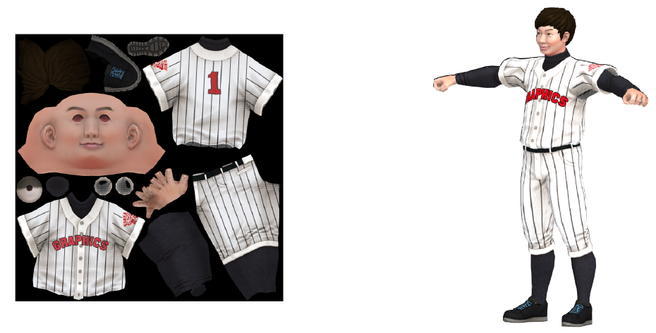
Modeling
A model is referred to as a computer representation of an object, and modeling is the process of creating the objects comprising the virtual scenes.
Almost all 3D models in real-time graphics are represented in polygon meshes.
The scope of modeling includes creating textures. The simplest form of a texture is an image that is pasted on an object's surface at run time.
1-<number>

Slide 5
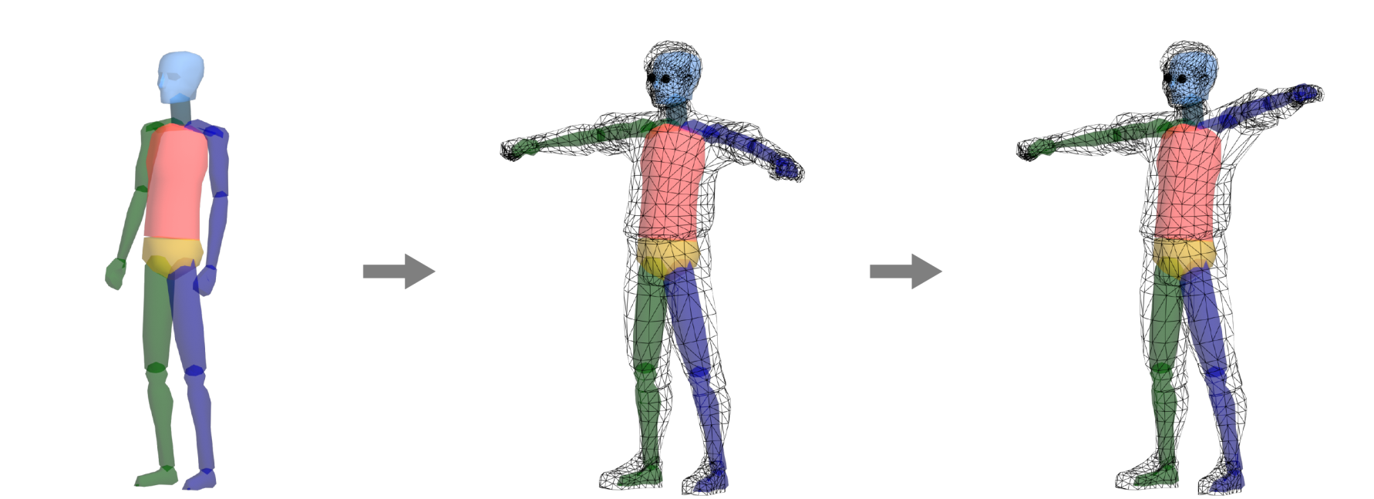
Rigging
The baseball player should be able to hit a ball, run, and slide into a base, i.e., we need to animate the player.
For this purpose, we usually specify the skeleton or rig of the player. We then define how the skeletal motion deforms the player’s polygon mesh such that, for example, the polygons of the arm are made to move when the arm bone is lifted. This process is often referred to as rigging.
skeleton
skeleton embedded in the mesh
animated mesh
1-<number>

Slide 6
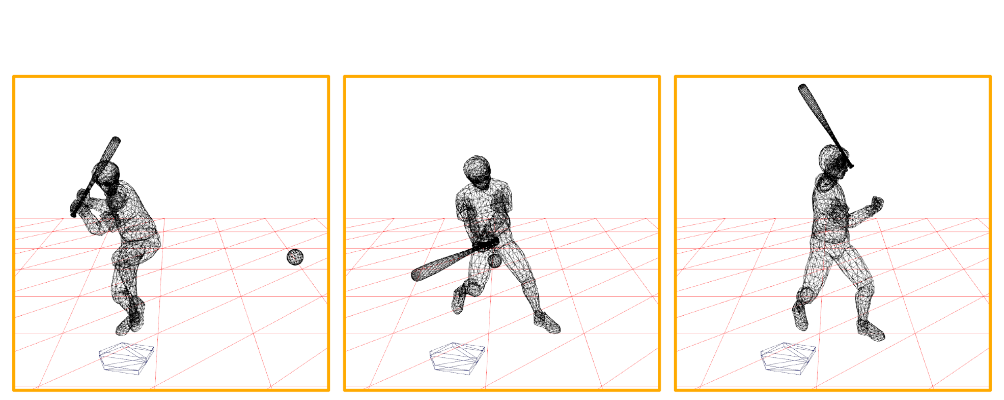
Animation
The graphics artist creates a sequence of skeletal motions. At run time, the skeletal motions are replayed and the polygon mesh is animated over frames.
The artists perform modeling, rigging, and animation in an off-line mode. Dedicated programs such as Autodesk 3ds Max and Autodesk Maya are popularly used.
1-<number>

Slide 7
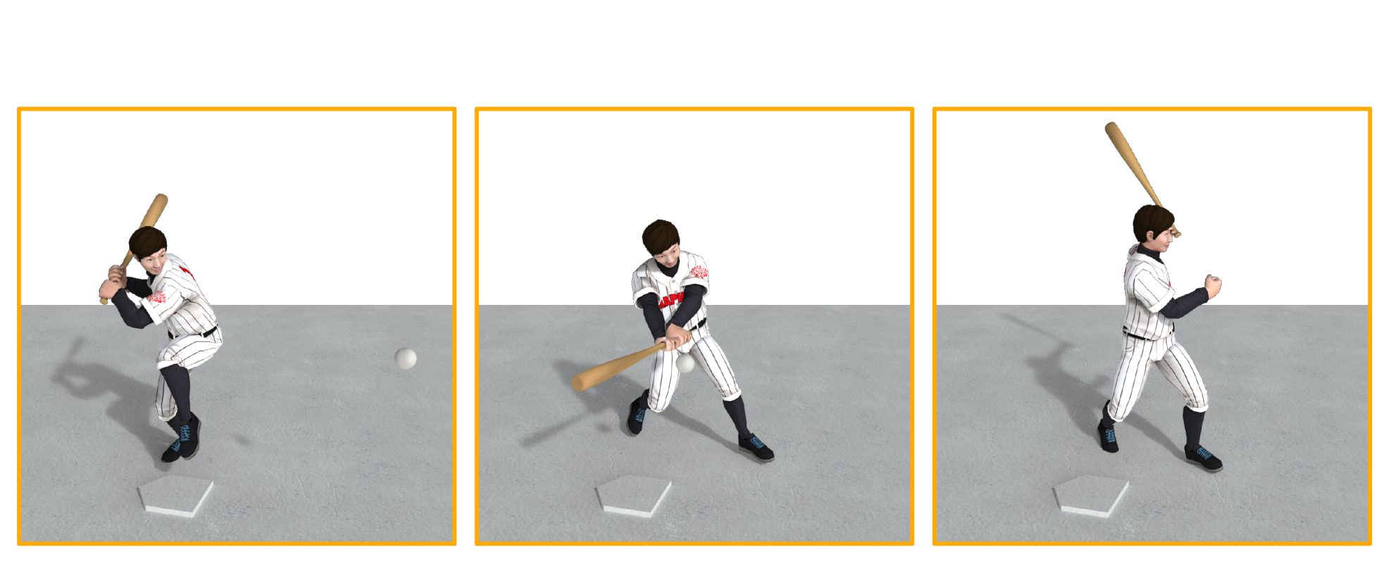
Rendering
Rendering is the process of generating a 2D image from a 3D scene. The image makes up a frame.
Realistic rendering is a complicated process, in which lighting as well as texturing is an essential component. For example, the shadow shown below is a result of lighting.
1-<number>

Slide 8
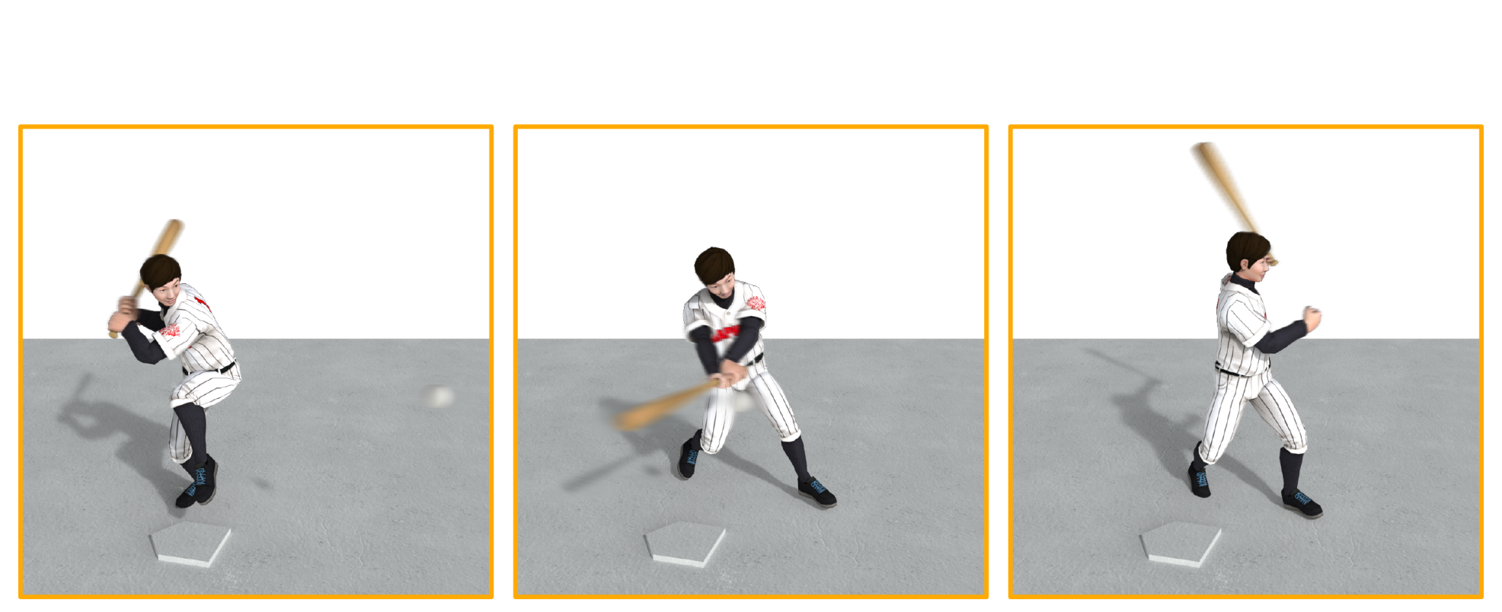
Post-processing
As an optional step, post-processing uses a set of special operations to give additional effects to the rendered images.
An example is motion blur. When a camera captures a scene, the resulting image represents the scene over a short period of time. Consequently, rapidly moving objects may result in motion blur.
1-<number>

Slide 9
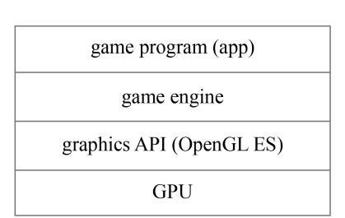
Graphics API
Unlike modeling, rigging, and off-line animation made by artists, run-time animation, rendering, and post-processing are by an application program.
In games, the application is typically built upon a game engine. A game engine is a development tool that provides a suite of indispensable modules for animation, rendering, and post-processing.
In general, a game engine is built upon 3D graphics APIs such as Direct3D and OpenGL. OpenGL ES (OpenGL for Embedded Systems) is a 3D API for handheld and embedded devices and is defined as a subset of OpenGL.
1-<number>

